Slide 1

HB 4124 Higher Education Study
Update for Board of Trustees
Trent Lutz, Exec Director of Government and Community Relations
Jamie Moffitt, Sr VP of Finance and Administration
October 22, 2026

Slide 2
History of HB 4124

Slide 3
How HECC Defines the Work:
House Bill 4124 directs the HECC to conduct a study of the condition of Oregon’s postsecondary education system and to develop detailed recommendations for the design, implementation and operation of a viable and improved institutional framework for public higher education in Oregon

Slide 4
Three Principle Goals:
Improve access for students across Oregon, including rural and underserved communities;
Strengthen regional and statewide economic development and employment; and
Improve the financial viability of both individual institutions and the system overall.

Slide 5


HB 4124 Support:

Slide 6
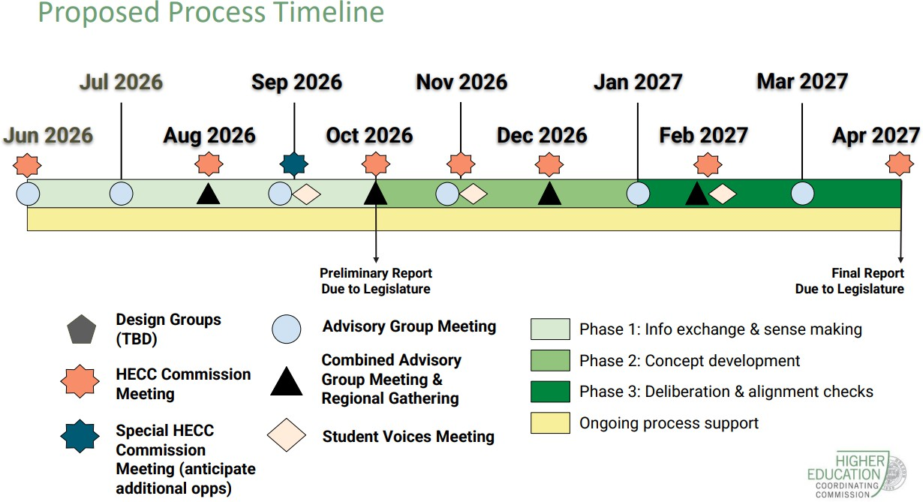

Slide 7
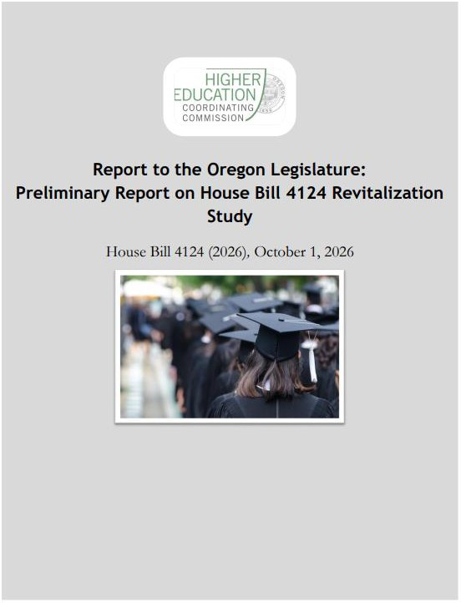
HECC delivered the preliminary report on HB 4124 on Sept 30th.

Slide 8
HB 4124 – Opportunities
The October HECC EY Parthenon report highlights the significant need for substantial investment in four-year universities
Low level of State Investment
High mandated fringe benefits costs
Need for more graduates to fuel Oregon Economy

Slide 9
Oregon state appro_{t}p_{h} riations at 4-year institutions lag most of the
country, ranking 46 among all states on a per FTE basis
Oregon ranks 46th
$11.1k
nationally for public 4-year education appropriations per FTE in FY25
State
Financial Aid
$1.5k
$10k
$8.3k
$8k
State Financial Aid
$1.1k
$6.5k
$6k
State
Financial Aid
$1.2k
State Operating
$9.6k
$4.2k
$4k
State
Financial Aid
$0.8k
State Operating
$7.1k
State
Operating
$5.3k
$2k
State Operating
$3.5k
$0k
OR - FTE U.S. - FTE OR - headcount U.S. - headcount
Figures are adjusted by a SHEEO cost-of-living factor (Cost of Living Index), which accounts for cost-of-living differences across states (decreases the displayed Oregon value below the nominal); SHEF excludes
research, agricultural, and medical (RAM) appropriations and FTE enrollment for students attending medical schools to improve cross-state comparability.
Headcount reflects IPEDS 2024-25 12-month unduplicated enrollment. Two-year sector includes public institutions classified as degree-granting but not primarily baccalaureate; 939 Oregon students (169,390
nationally) are excluded from the public four-year denominator to align with SHEF's exclusion of medical/professional-practice enrollment.
Source: SHEEO SHEF FY25 Report

Slide 10
Context for State Funding Figures for Four Year Universities
FY27 Public University Support Fund (“PUSF”)
operating funds for all seven campuses: $545 million
Oregon – Average state funding per FTE: $5,300 per year
US – Average state funding per FTE: $9,600 per year
Difference: $4,300 per FTE
Total projected funding gap from US Average: $365.5 million
This represents 67% of the current PUSF

Slide 11
Oregon’s 2-year colleges receive similar state and local
investment relative to the country on both a per FTE basis
(ranking 20th among all states) and per headcount
Oregon public 2-year higher education appropriations (operating and financial aid) per FTE and headcount^{1,2} (FY25)
Oregon's community colleges are governed by locally elected boards and receive a significant share of their funding from local sources
$12k
$11.6k
$11.1k
$10k
Local
$4.2k
Local
$3.6k
Funding per headcount is especially lower for 2-year institutions due to the much higher share of part-time students who still carry substantial student support needs
$8k
State
Financial Aid
$1.3k
State
Financial Aid
$0.8k
$6k
$4.6k
$4.6k
$4k
State
Operating
$6.7k
Local
$1.7k
Local
Oregon ranks 20
th
State Operating
$6.1k
State
$1.5k
nationally for public 2-year education appropriations per FTE in FY25
State
Financial Aid
Financial Aid
$0.3k
$2k
$0.5k
State
State
Operating
$2.8k
Operating
$2.4k
$0k
OR - FTE U.S. - FTE OR - headcount U.S. - headcount
Figures are adjusted by a SHEEO cost-of-living factor (Cost of Living Index), which accounts for cost-of-living differences across states (decreases the displayed Oregon value below the nominal); SHEF excludes research, agricultural, and medical (RAM) appropriations and FTE enrollment for students attending medical schools to improve cross-state comparability.
Headcount reflects IPEDS 2024-25 12-month unduplicated enrollment. Two-year sector includes public institutions classified as degree-granting but not primarily baccalaureate.
Source: SHEEO SHEF FY25 Report

Slide 12
Oregon’s public universities and colleges face fringe rates that
are meaningfully higher than national averages
Personnel expenditures as a share of total expenditures, by natural expense category^{1,2} (FY24)
100%
$4.0b $242.8b $1.4b
$53.9b
Other natural expenses
& deductions 25%
Other natural expenses & deductions
18%
Interest 4%
Depreciation 7%
Operations & maintenance
of plant 7%
Other natural expenses
& deductions
24%
Other natural expenses
& deductions 27%
Mandated state benefit programs are a primary driver of fringe costs, which as a share of personnel expenditures run
~58% higher than
national peers at 4-years and ~45% higher at 2-years
80%
Interest 2%
Depreciation 7%
Operations & maintenance
of plant 4%
Interest 2%
Depreciation 7%
Operations & maintenance
of plant 7%
Interest 2%
Depreciation 7%
Operations & maintenance
of plant 9%
60%
Fringe benefits 24%
Fringe benefits
14%
Fringe benefits 24%
Fringe benefits 15%
40%
20%
Salary and wages
38%
Salary and wages 43%
Salary and wages 40%
Salary and wages 43%
0%
Oregon 4-year publics
National: 4-year publics
Oregon 2-year publics
National: 2-year publics
Personnel
expenses as %
of total
62%
57%
64%
58%
Employee fringe benefits include retirement plans, social security taxes, medical/dental plans, guaranteed disability income, tuition plans, housing plans, unemployment compensation plans, group life insurance plans, worker’s
compensation plans, and other benefits in-kind with cash options.
Institutions with hospital services expenditures are excluded from this analysis.
Source: IPEDS; EY-Parthenon analysis

Slide 13
Context for Fringe Benefits Cost for Four Year Universities
Fringe benefits cover mandatory state benefits programs – PERS and PEBB
Average fringe benefit costs in Oregon: 24% of total costs
Average fringe benefit costs in US: 14% of total costs
Differential: 10% of total costs
Oregon: Total annual cost for all seven campuses:
$4.0 billion
Cost of differential fringe: $400 million per year

Slide 14
Overall Summary
FY27 Public University Support Fund (“PUSF”)
operating funds for all seven campuses: $545 million
Funding gap for Oregon Four Year Universities from US Average: $365.5 million
Extra Cost of Differential Fringe Benefit rates charged to Oregon Four Year Universities vs. US Average: $400 million per year

Slide 15
Chapter 3: Summary
Chapter 3 focuses on the relationship between higher education and the state’s economy
Importance of Higher Education: Of the 2.2m jobs in Oregon, 40% of them require higher education at the entry level. To advance beyond the entry level, ~65% of jobs require higher education. And when you consider the subset of job categories where the median wage is a living wage or more, approximately 95% of jobs require higher education
And Oregon is not producing enough graduates for the jobs in the state. Oregon (including its private institutions) only produces about ~52k graduates a year, well under the ~78k new jobs that open a year. While this analysis is both directional and conservative, it deviates significantly from the trend at a national level
  Shortfalls are prevalent at both the middle- and high-skills levels, and vary in acuity by field and occupation
The situation is likely to worsen. Oregon population growth has flattened in recent years, and in-migration has decreased. Long-term demographic challenges are likely to put pressure on undergraduate enrollments

Slide 16
Student outcomes vary widely across Oregon institutions, with
completion rates ranging from ~40-70% among both universities
and community colleges
Oregon 4-year public institutions: completion rates¹ (FY25)
Oregon 2-year public institutions: completion/transfer rates² (FY25)
80%
Research Regional Specialized
72%
80%
69%
70%
69%
68%
71%
71%
64%
61%
63%
60%
60%
60%
57%
59%
58%
55%
_{54%} 55%
55%
47%
48%
49%
49%
47%
50%
42%
40%
Some positive outcomes may not be captured in these rates, including transfers to
non-reporting institutions and
completions by part-time students
beyond four
years
40%
40%
20%
20%
0%
OSU
UO
PSU WOU EOU SOU
OIT
0%
BMCC
COCC
Chemeketa
Clackamas
Clatsop
CGCC
KCC
Lane
LBCC
MHCC
OCCC
PCC
RCC
SWOCC
TBCC
TVCC
UCC
FY20 | 72% | 76% | 52% | 52% | 39% | 53% | 56%
When benchmarking OR vs. the nation using IPEDS data, Oregon’s public
universities appear to perform slightly above national averages on
FY20 | 56% | 57% | 50% | 47% | 44% | 50% | 57% | 50% | 61% | 43% | 58% | 52% | 48% | 64% | 52% | 57% | 64%
completion, while colleges lag the nation on completion/transfer outcomes
Public university student completion rates represent the percentage of first-time, full-time freshmen who earned a bachelor’s degree within six years at any public university.
Community college student completion rates represent the percentage of credential-seeking students who earned an associate degree, certificate, or transferred to a four-year university nationwide within four
years.
Source: HECC Institutional Data Dashboards

Slide 17
HB 4124 Next Steps

Slide 18
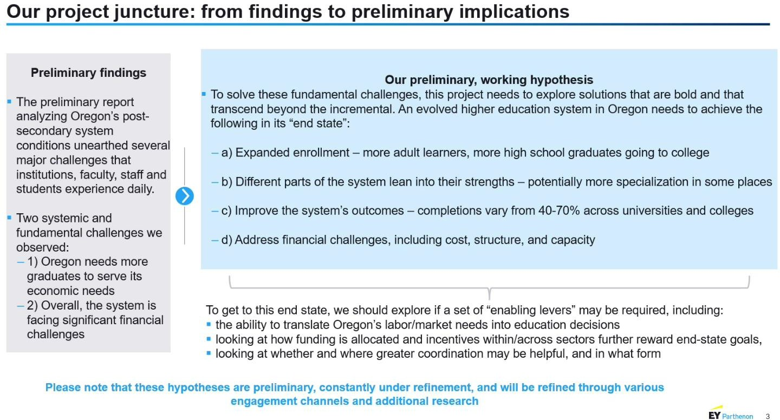

Slide 19
HB 4124 Technical Working Groups
Expanding Enrollment
Improving System Outcomes
Institutional Differentiation
Addressing Financial Challenges
System Levers

Slide 20
HB 4124 – Risks
Rushing to move solutions before knowing the impacts
Further “efficiencies” through mandatory system
wide shared services
Disruptions and changes to governance structures
Challenges to institutional differentiation / competition

Slide 21
Our Goals:
Allow the process to produce well tested recommendations
Require evidence that proposed changes will deliver benefits
Build collaboration around strong institutional missions
Keep student opportunity at the center
Make sustainable investment central to the recommendations

